Slide 1





We are reflecting on how committed we are to
Key Learning:
How Committed am I?

Slide 2










Slide 3









Religious Education (RE) helps develop our knowledge of the world's religious traditions.
It helps promote tolerance and understanding.
Learn about our own personal development.
Ask spiritual, moral, social and cultural questions.
Challenge stereotypes and promote equality and understanding among people.

Slide 4

Hinduism
Christianity
Judaism
Islam
Buddhism
Sikhism

Slide 5






3. Self-sacrifice of Sikhs: fighting in
wars
1. Comparing levels of commitment
2. The five key Sikh beliefs
6. Ranking Sikhs’
Commitment
5. The Langar & The
Golden Temple
4. Putting others before themselves
Our outcome:
We will reflect on how committed we are to certain things in life and why.

Slide 6
God is in everything (Sikhs see God as an energy source rather than as a physical entity) and it is a Sikh’s duty to serve others
All people should be treated as equals.
Sikhs should share what they can with others
Sikhs should earn their living honestly
The purpose of life for a Sikh is to see and speak with
god (through meditation by saying ‘Waheguru’).

Slide 7
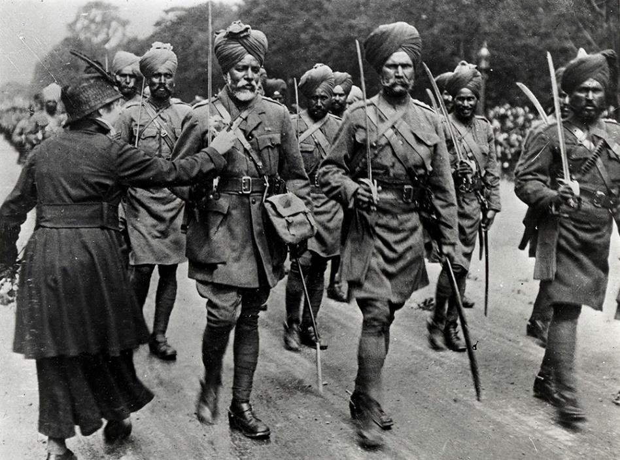
What do these pictures show about Sikh commitment to their religion?

Slide 8




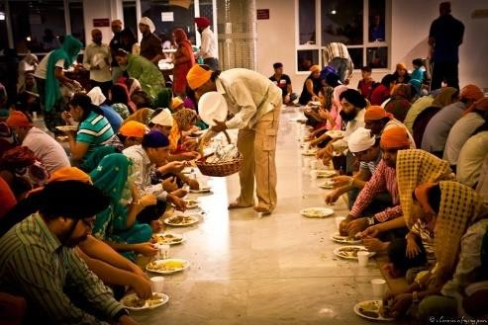
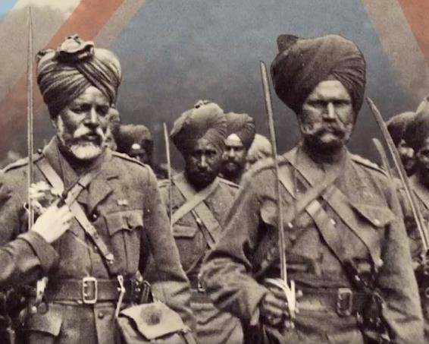
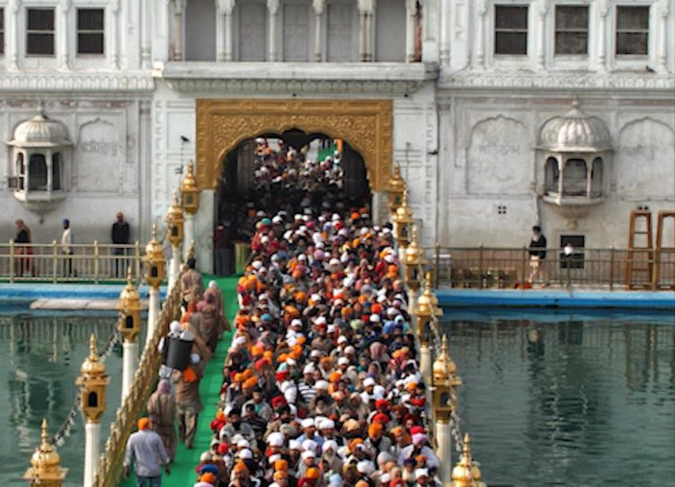
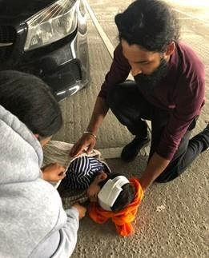

This picture shows Sikhs feeding people in need at the Langar.
Rank these pictures in order of what you think requires the most commitment to Sikhism. Explain why you put each one where you did.
It is important to share
what you have with
other people, and it’s a
regular commitment.

Slide 9





Why do Sikhs put
Is it OK that not
so much effort
all Sikhs put the
into their
same amount of
religion?
effort in?

Slide 11
a) Why do Sikhs put so much effort into their religion?
a) Why do Sikhs put so much effort into their religion?
b) Is it OK that not all Sikhs put the same amount of
b) Is it OK that not all Sikhs put the same amount of
effort in?
effort in?
a) Why do Sikhs put so much effort into their religion?
a) Why do Sikhs put so much effort into their religion?
b) Is it OK that not all Sikhs put the same amount of
b) Is it OK that not all Sikhs put the same amount of
effort in?
effort in?
a) Why do Sikhs put so much effort into their religion?
a) Why do Sikhs put so much effort into their religion?
b) Is it OK that not all Sikhs put the same amount of
b) Is it OK that not all Sikhs put the same amount of
effort in?
effort in?
a) Why do Sikhs put so much effort into their religion?
a) Why do Sikhs put so much effort into their religion?
b) Is it OK that not all Sikhs put the same amount of
b) Is it OK that not all Sikhs put the same amount of
effort in?
effort in?
a) Why do Sikhs put so much effort into their religion?
a) Why do Sikhs put so much effort into their religion?
b) Is it OK that not all Sikhs put the same amount of
b) Is it OK that not all Sikhs put the same amount of
effort in?
effort in?
a) Why do Sikhs put so much effort into their religion?
a) Why do Sikhs put so much effort into their religion?
b) Is it OK that not all Sikhs put the same amount of
b) Is it OK that not all Sikhs put the same amount of
effort in?
effort in?

Slide 12


Slide 13




