Slide 1
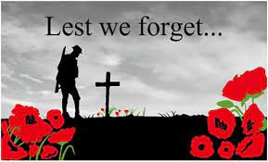
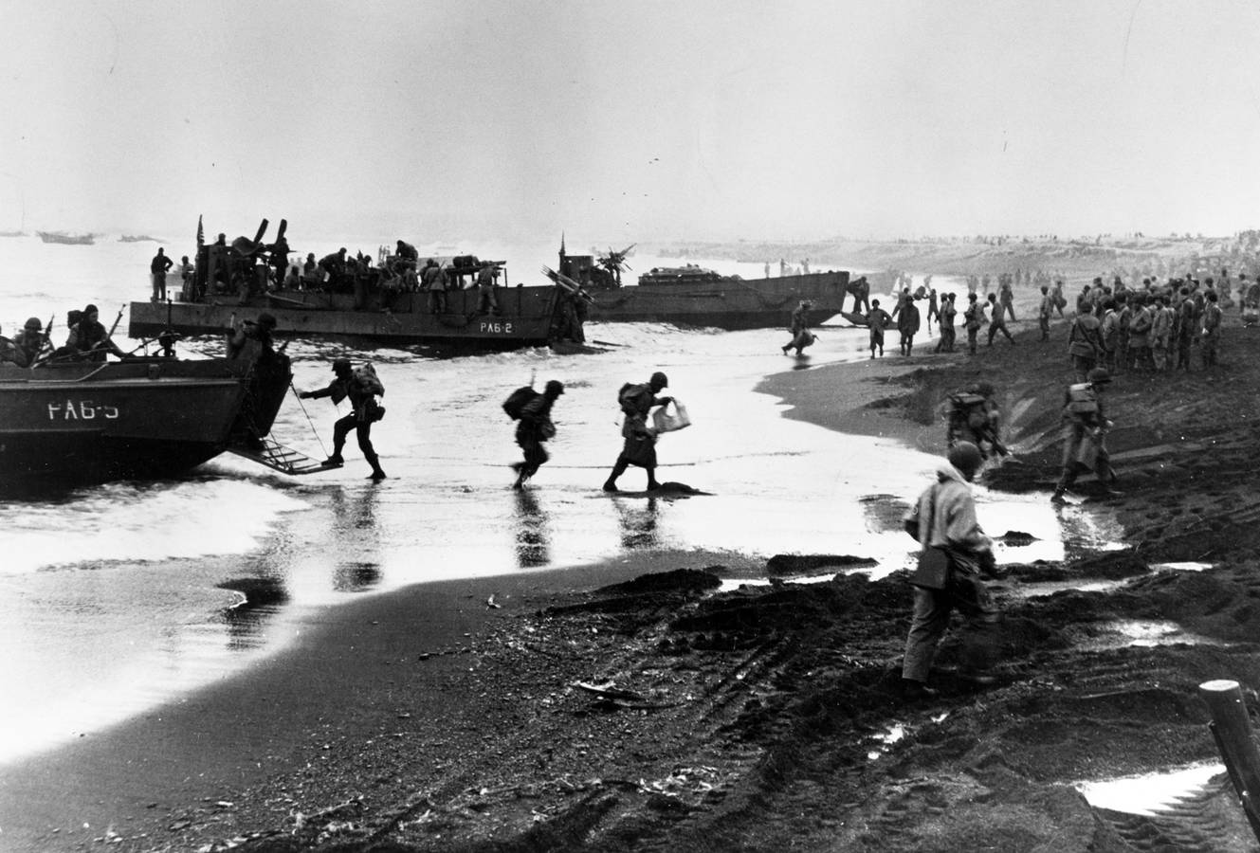
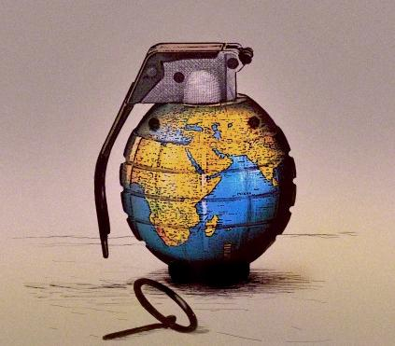
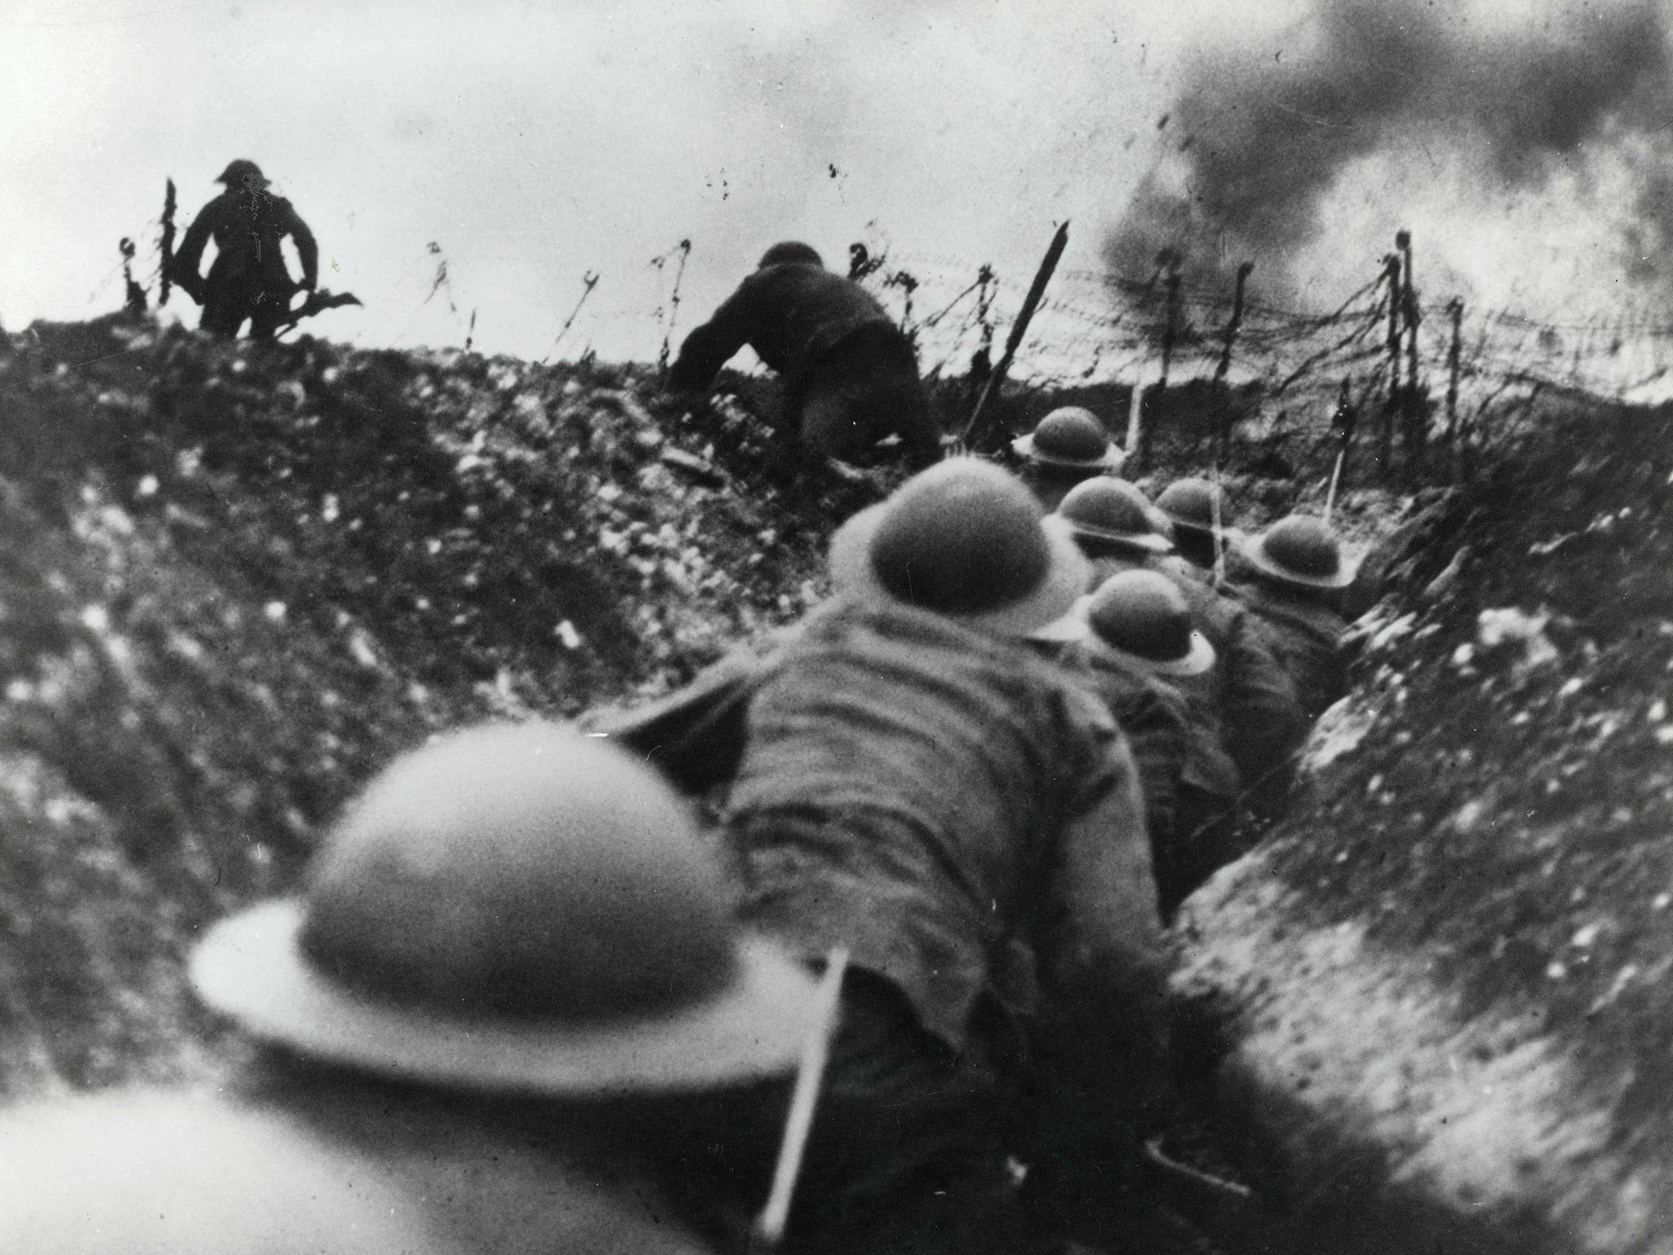
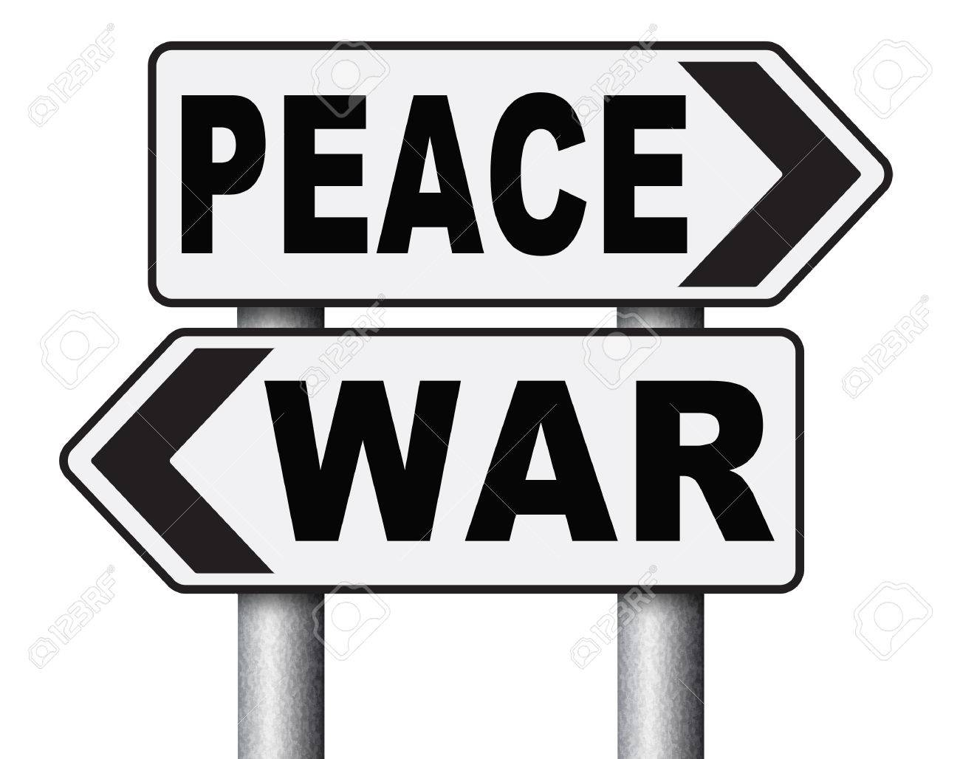
History Term:
Conflict
Our Learning Journey:
1. Why are there Wars?
Questions about conflict
2. Remembrance
4. World War II
1939 - 1945
5. Modern
conflicts
6. The impact of war.
3. World War I
1914 - 1918
Why are we learning this?
Our Outcome:
To get a better understanding of our country’s and World’s past, so that we can learn from the mistakes made and try and avoid the terrible sacrifice of people’s lives that war brings.
A P4C discussion on whether we can learn from Historical conflict and make World Peace a possibility.
Vocabulary:
political | combat
genocide | warfare
Axis | allied/allies

