Slide 1
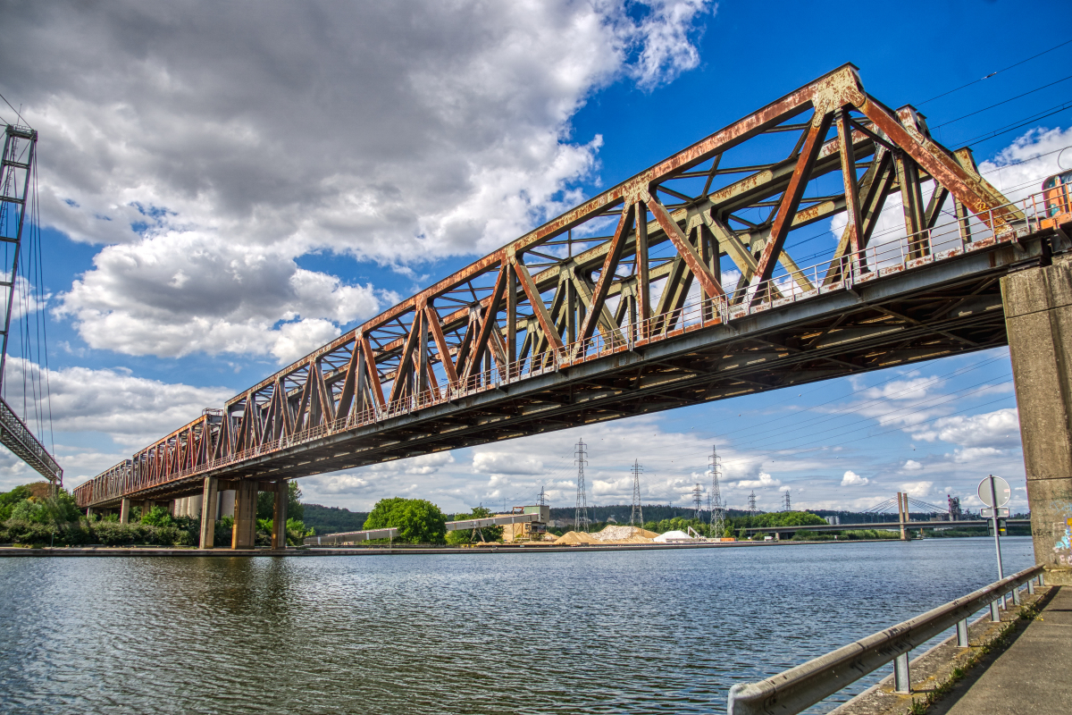
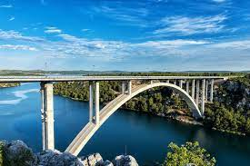
DT Term:
Bridges
Our Learning Journey:
Arch and beam bridges
Spaghetti truss bridges
Build a wooden truss bridge
Complete, reinforce and evaluate a truss bridge
Why are we
learning this?
Our Outcome:
DT develops your skills and knowledge in design, structures, mechanisms, electrical control and a range of materials, including food. It encourages your creativity and encourages you to think about important issues.
Design and construct a bridge across a body of water, which can carry a load without collapsing.
Vocabulary:
rigid | corrugation
stability | truss
lamination | aesthetics

